Slide 1
GHG Analysis
Problem Statement
Project will analyze energy usage and greenhouse gas (GHG) emissions of Ontario's Broader Public Sector (BPS) organizations, leveraging a comprehensive database of reported data. We aim to identify trends, assess conservation effectiveness, and pinpoint areas for improvement, informing data-driven strategies to achieve climate change mitigation goals within the BPS.
Tools Used
Python
Pandas
Numpy
PowerBI

Slide 2

Approaches
Dataset Preprocessing and Cleansing
Cleaning of the features of Data.
Handled the missing values.
Deriving relevant features
Segment the data by relevant factors Year, Sector, Organization, City
Dropped the features with 96-99% of null data.

Slide 3
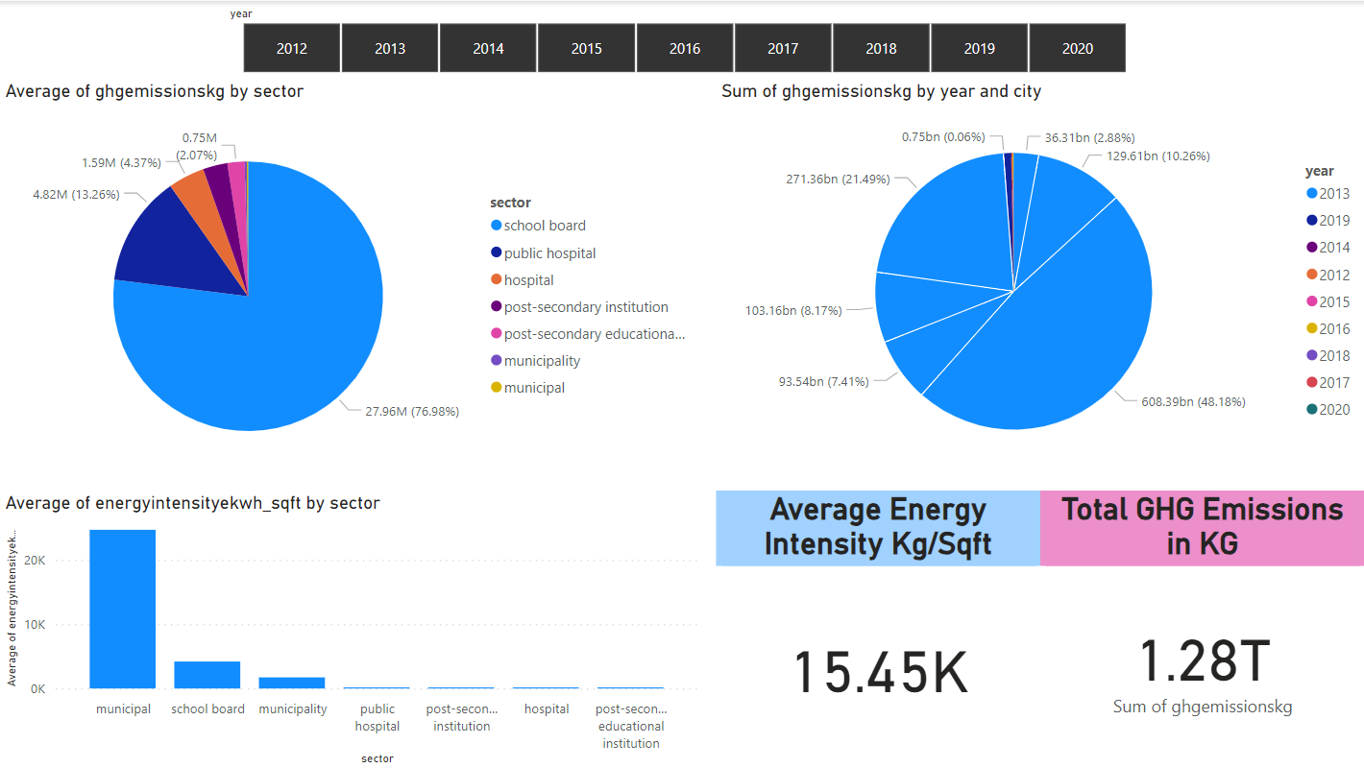
EDA Insights
Year 2013 being the highest year with more GHG Emission, with which North Bay being a 48% of contributor in an overall emission of this year
Toronto being the highest GHG emission city during other years

Slide 4
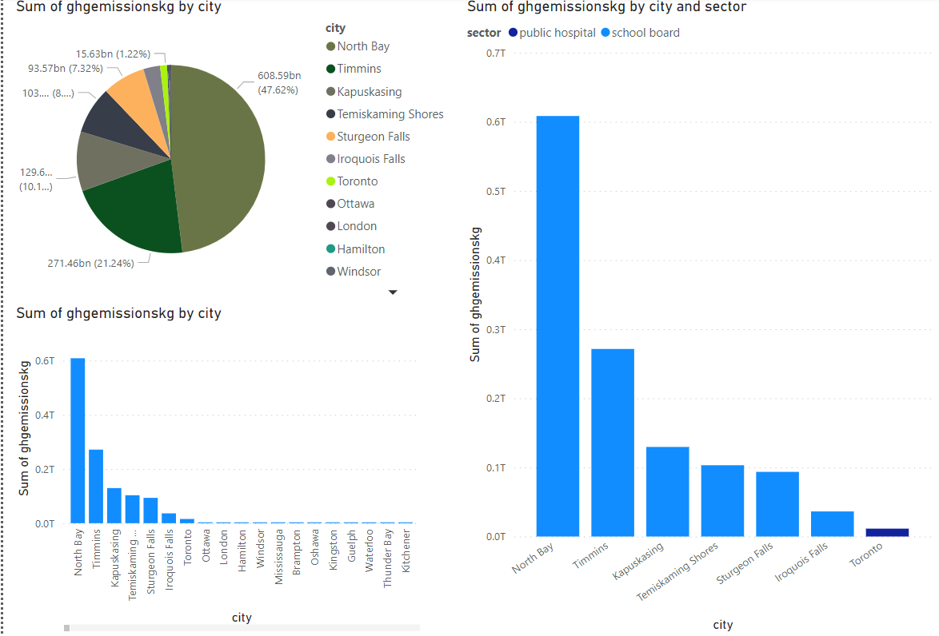
EDA Insights
In overall data NorthBay is the highest contributor of emission data and it is specifically high in the School sector
Toronto is the highest GHG emission city in public sector

Slide 5
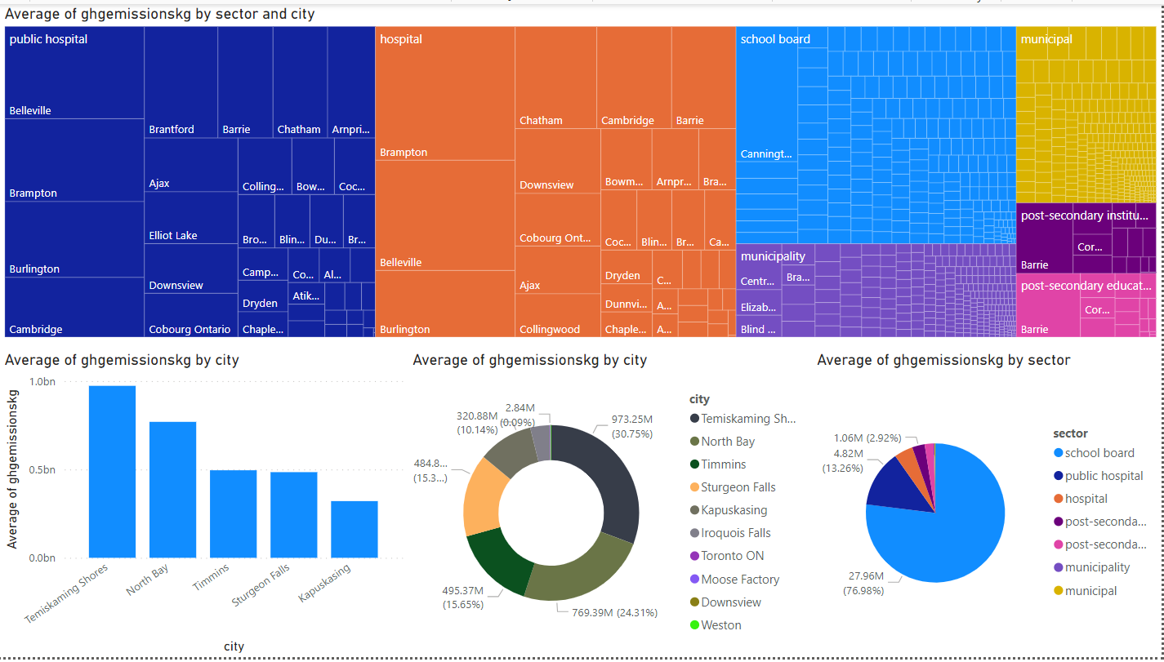
EDA Insights
On an average public hospital sector being highest in Bellevile city
Hospital being the highest in Brampton city
School board being the highest in Cannington city
Temiskaming shores being the highest in average GHG emitting city in overall data and school board being in the top of average compared to other sectors

Slide 6

Conclusion
Top Cities of GHG Emission
Temiskaming shores
North Bay
Toronto
Top Sectors of GHG Emission
School Board
Public Hospital
Hospital
Considering the insights these cities and sectors should incline towards alternate sources of energy to eliminate the GHG emissions.

